Slide 1




Cincinnati’s GIS-based Customer Service Request System:
15 Years of Success
Alexandria Horne & Joshua Murphy
Senior Computer Programming Analysts
Cincinnati Area Geographic Information System (CAGIS)
Ohio GIS Conference
September 25 – 27, 2017
Hyatt Regency Columbus
Columbus, Ohio

Slide 2


Presentation Outline
Introduction to CAGIS
Customer Service Request (CSR) System
• Introduction
History
Key Features
GIS Integration
System Architecture
Recent System Enhancements
Results and Metrics
Future Enhancements

Slide 3


INTRODUCTION TO CAGIS

Slide 4
What is CAGIS?
CAGIS was founded in 1986 as a shared-services organization that provides services and solutions, integrated with land and infrastructure information, to its enterprise members.
A sampling of the services and solutions we provide:
Permitting
Licensing
Inspections
Code Enforcement
Planning
Zoning
Land and Infrastructure Asset Management
Who we serve:
City of Cincinnati Agencies (Department of Public Services, etc.)
Hamilton County Agencies (Auditor, Engineer, etc.)
Utilities (Duke Energy, Metropolitan Sewer District, etc.)
Communities (City of Blue Ash, Colerain Township, etc.)
Non-profits (Cincinnati Public Schools, etc.)
Private Organizations (National Inspection Company, etc.)

Slide 5
CUSTOMER SERVICE REQUEST SYSTEM (CSR)

Slide 6
Cincinnati Service Request System (CSR)
A system created by CAGIS that allows for enterprise-wide management of service requests and customer interaction.
Went live in 2002
Created and supported by CAGIS.
GOAL: effectively manage a service request throughout its entire “life” - from intake to resolution.
GOAL: view all enterprise wide work at any particular location.
GOAL: improve service coordination amongst city departments thus improving city services to the community.

Slide 7
CSR’s Key Features
Automation! work-order dispatching, e-mail updates, reporting, etc.
Give the public options for requesting service. call center, website, e-mail, mobile application.
Provide a dynamic knowledge base of telephone numbers, departments, events, and reference information searchable by category or keyword.
Performance analysis tools including on-demand metrics and reports.
GIS Integration

Slide 8
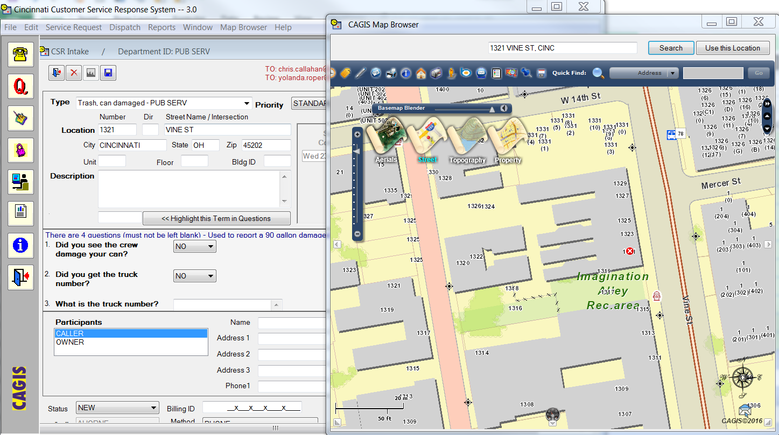
GIS Integration
The CSR system relies on two-way communication between its applications and our GIS data to create, manage and resolve service requests.

Slide 9



System Architecture
PUBLIC
Service Requests
CITY STAFF
CAGIS STAFF
GIS Database
Permits Database
Document Management System
CSR Desktop
CSR Administrator
CAGIS
ENTERPRISE

Slide 10






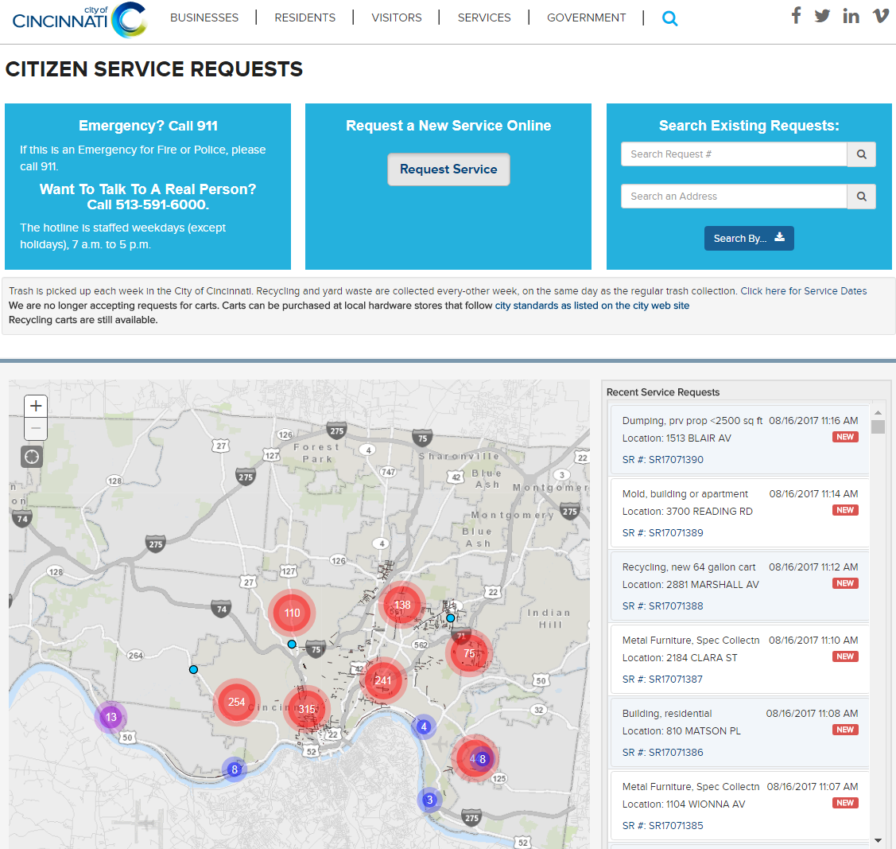
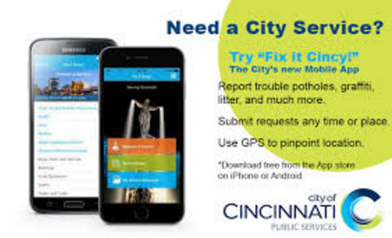

Service Request Submission
Public
Call Center CSR Desktop
Website 5916000.com
E-mail
Mobile App
Fix It Cincy!
CAGIS Enterprise System
CSR Administrator

Slide 11
RECENT SYSTEM ENHANCEMENTS

Slide 12
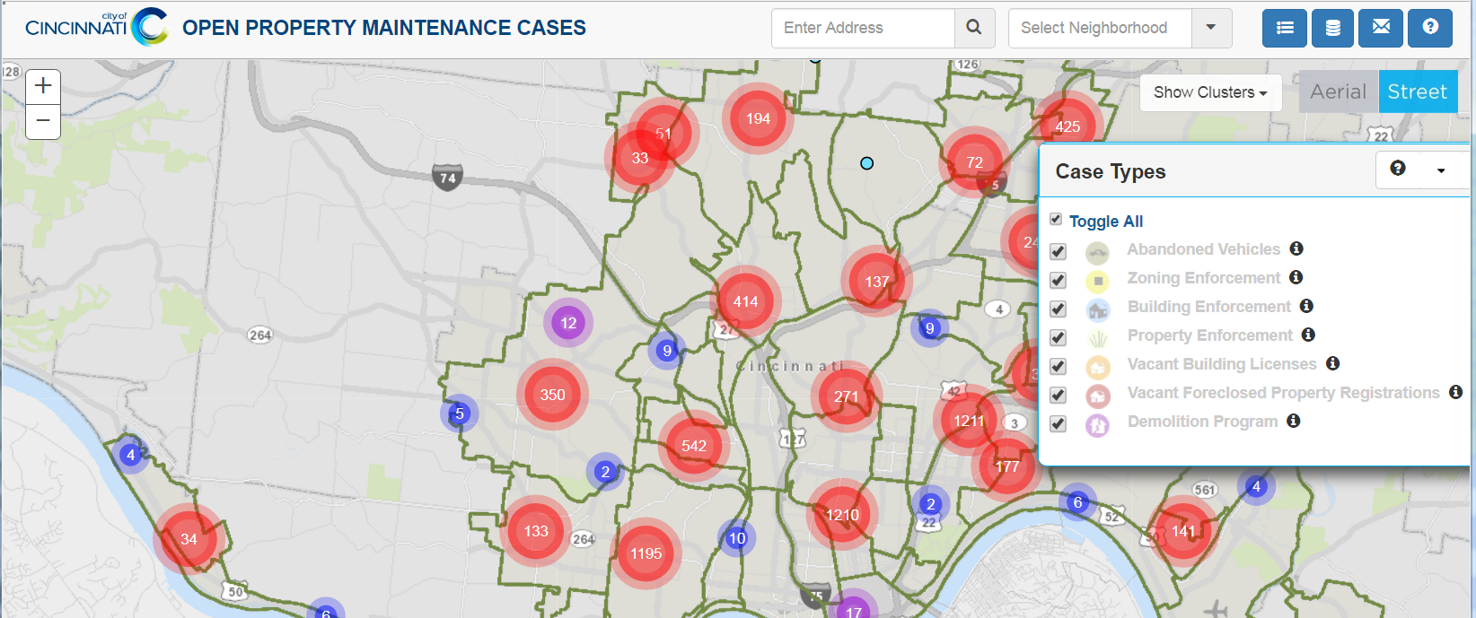
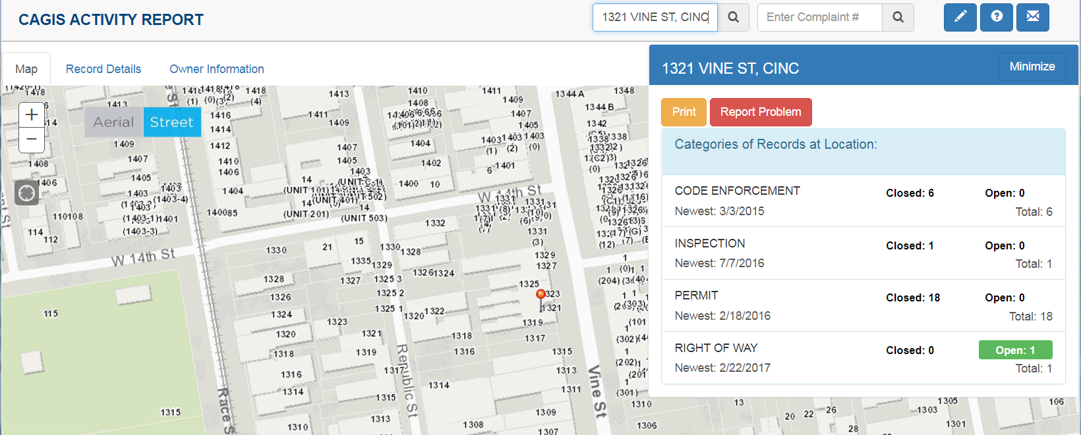
New Feature: Public Websites
Open Property Maintenance Cases
Property Activity Report

Slide 13
Enhancement: Customer Photo Uploads

Slide 14
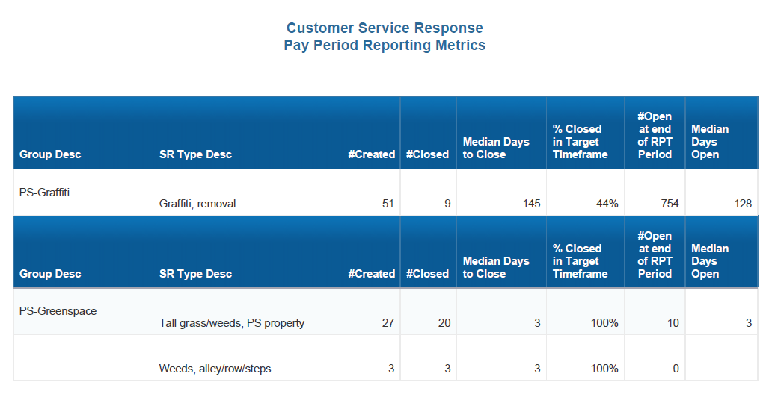
Enhancement: Scheduled and on-demand Reports for Staff

Slide 15
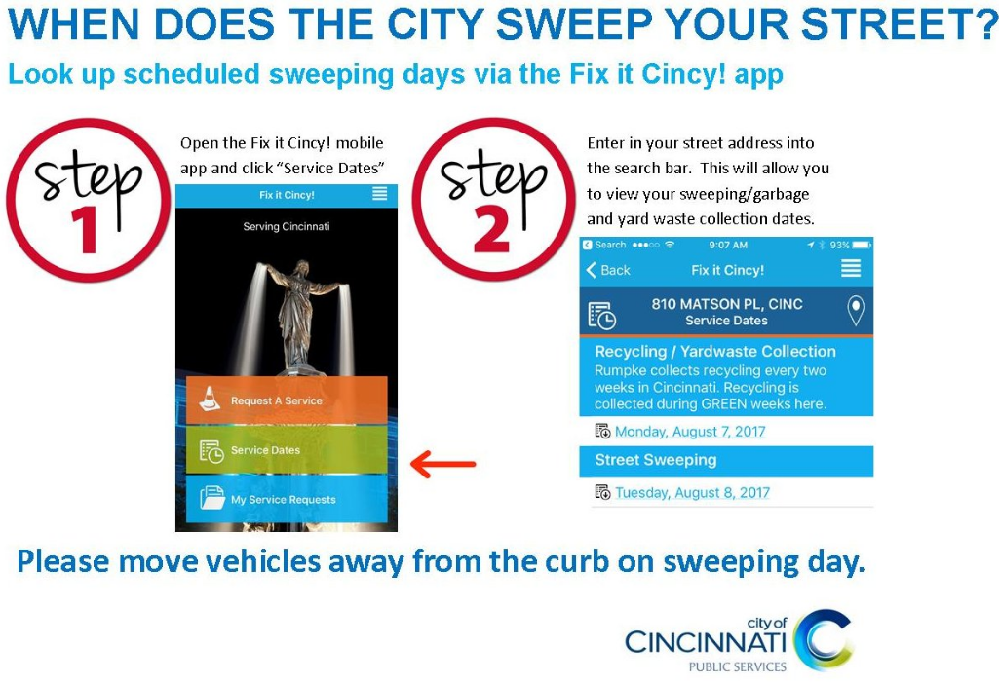



Enhancement: Increased Marketing

Slide 16
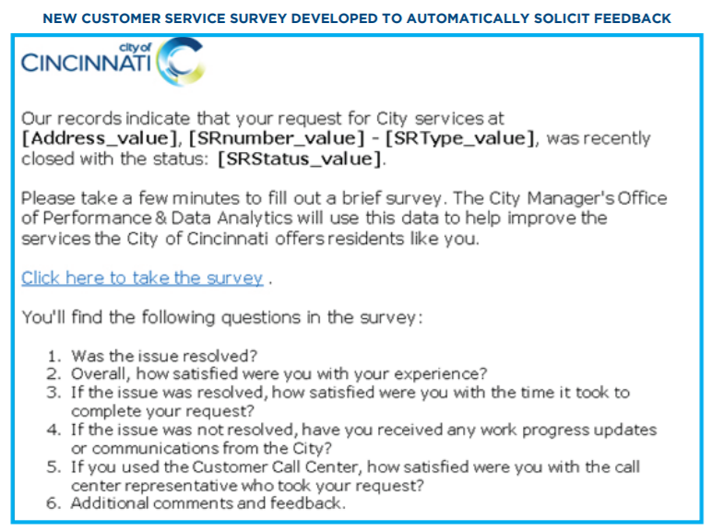
Enhancement: Customer Service Survey

Slide 17
RESULTS AND METRICS

Slide 18

Results
In 2016:
59% Reduction in Backlog (DOTE)
75% Reduction in Backlog (DPS)
Improved Trash Collection
Increased Customer Satisfaction
Decrease in Abandoned Calls
Decrease in Average Response Time

Slide 19
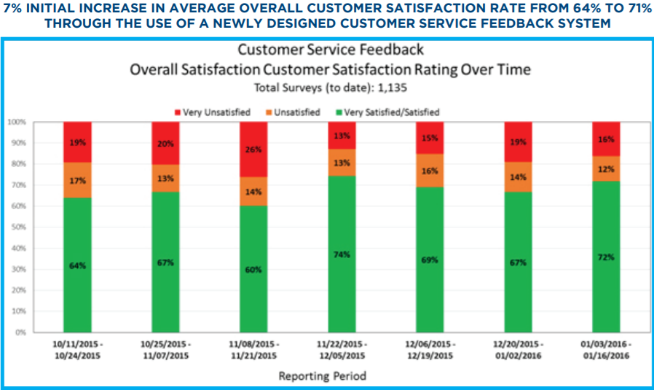
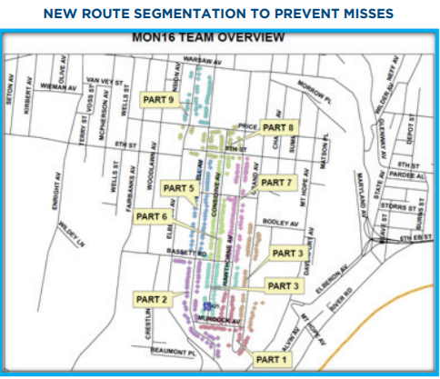
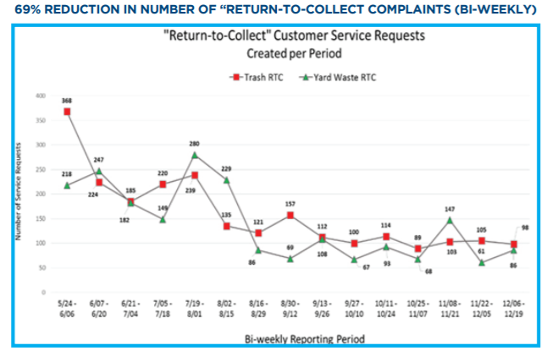
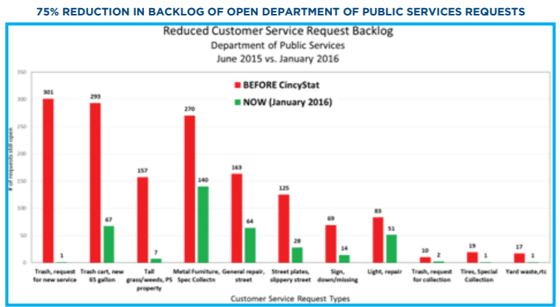
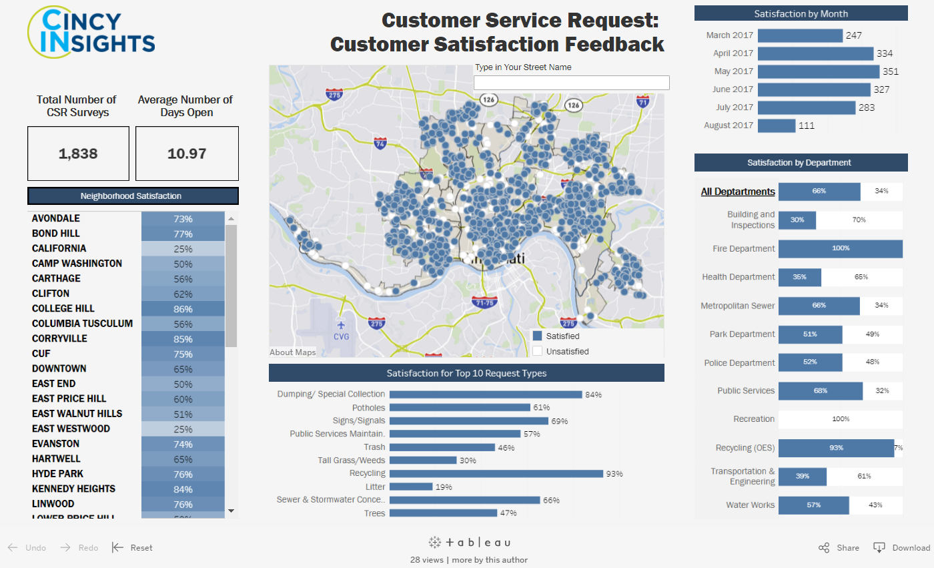
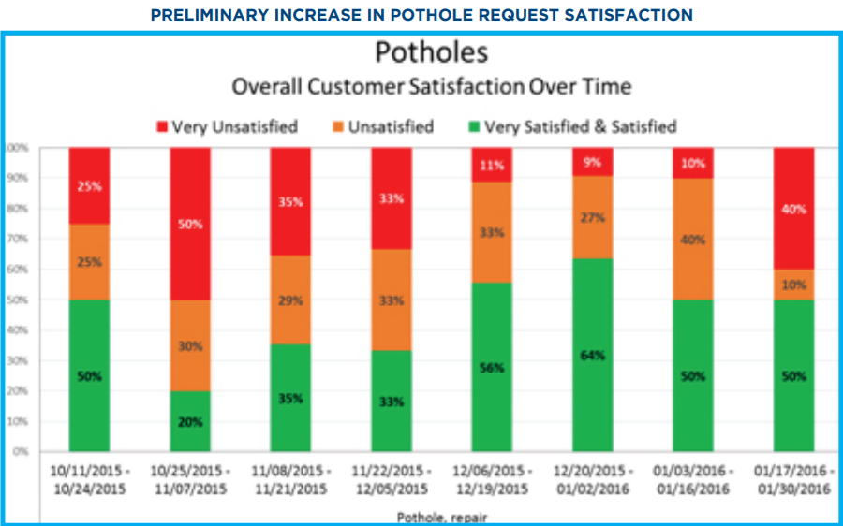
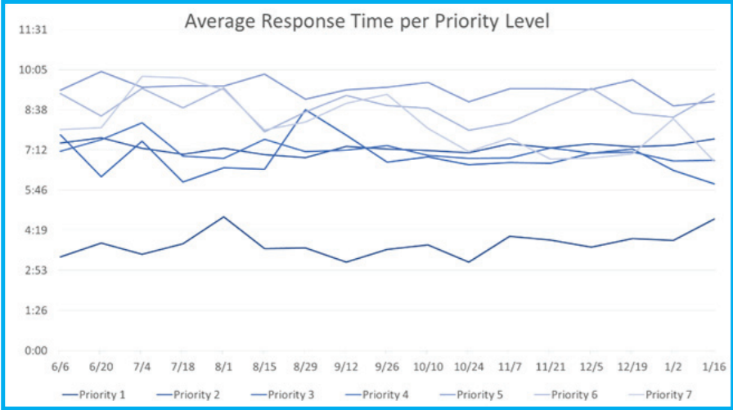
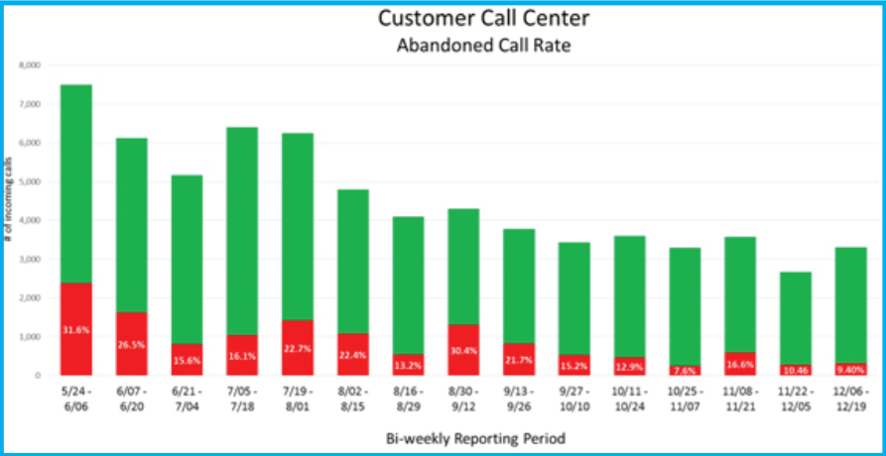
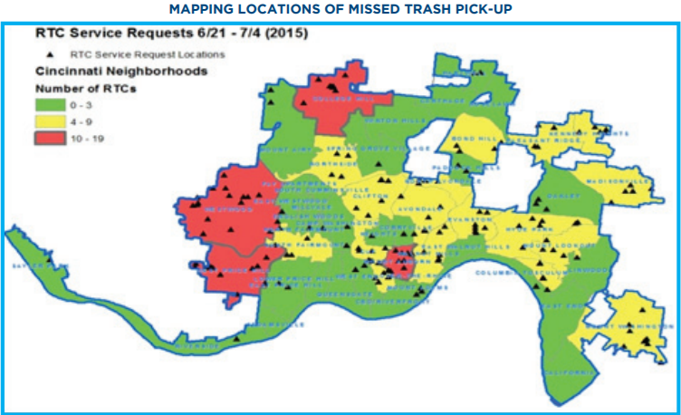
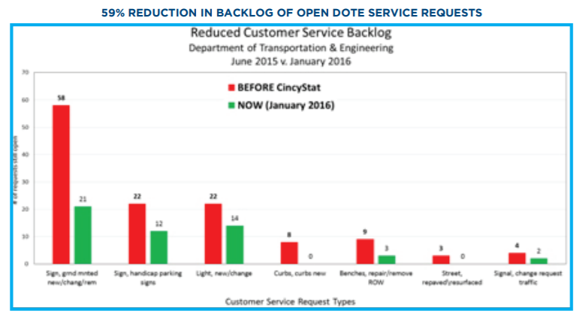


DATA…SO MUCH DATA
Just Google
“Open Data Cincinnati”

Slide 20
FUTURE ENHANCEMENTS

Slide 21
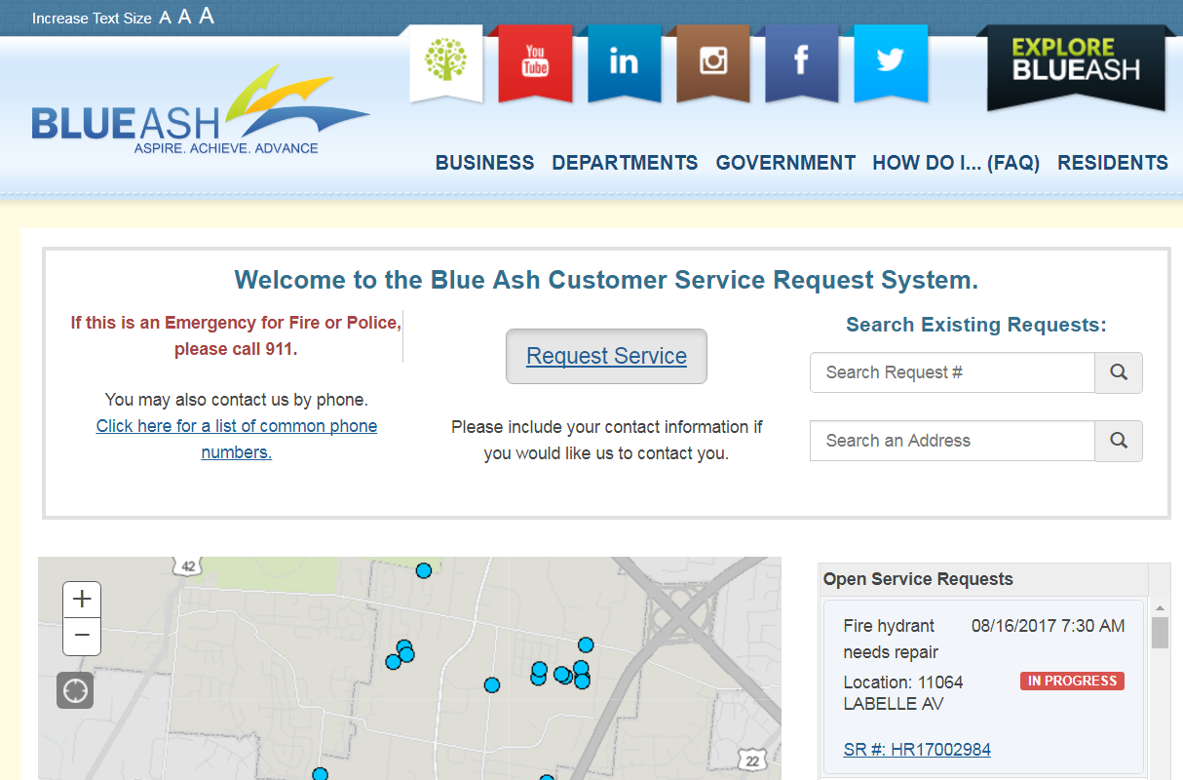
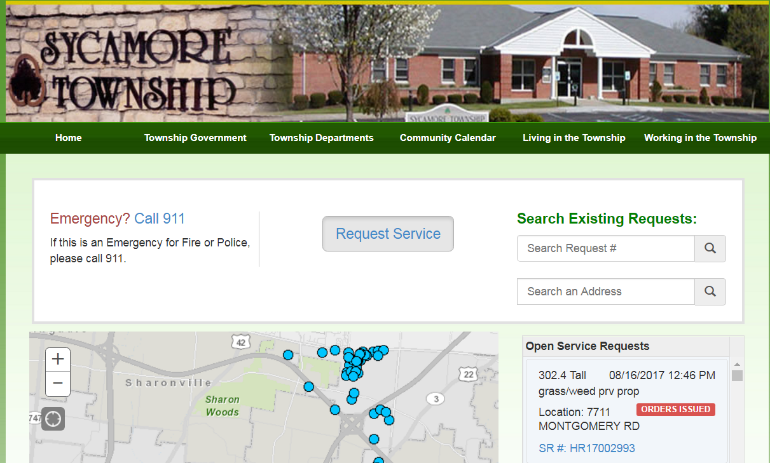
Future Enhancements
Projects underway include:
Automation and enterprise tracking of city-owned property and right-of-way.
Inventory of poles and signage.
Improvement of data to link requests to infrastructure features.
Creation & rollout of CSR systems for other communities.

Slide 22
Thank you for your time!
Are there any questions?
Alexandria Horne
alexandria.horne@cincinnati-oh.gov
Joshua Murphy
joshua.murphy@cincinnati-oh.gov

